Slide 1
Centripetal forces and energy

Slide 2
Motion in a circle

Slide 3
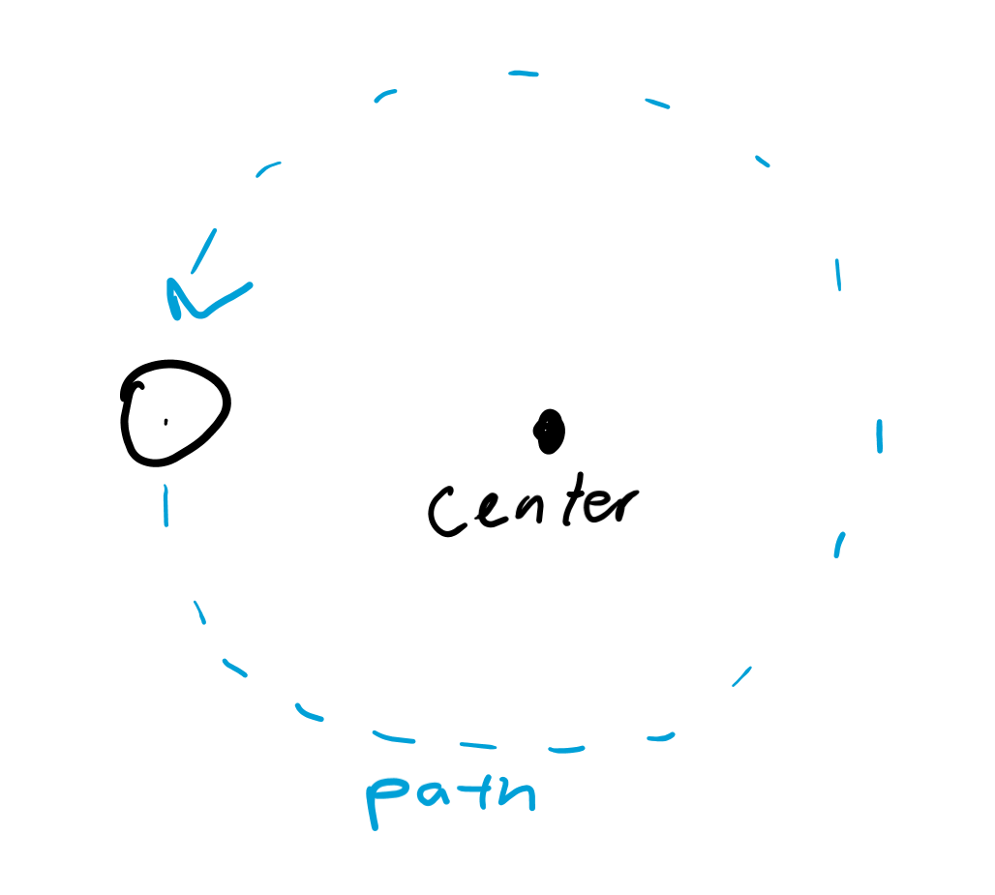
Path travelled
The object will travel in a circle to form. . . circular motion.
Generally there will be a center of motion from which the object will rotate from.

Slide 4
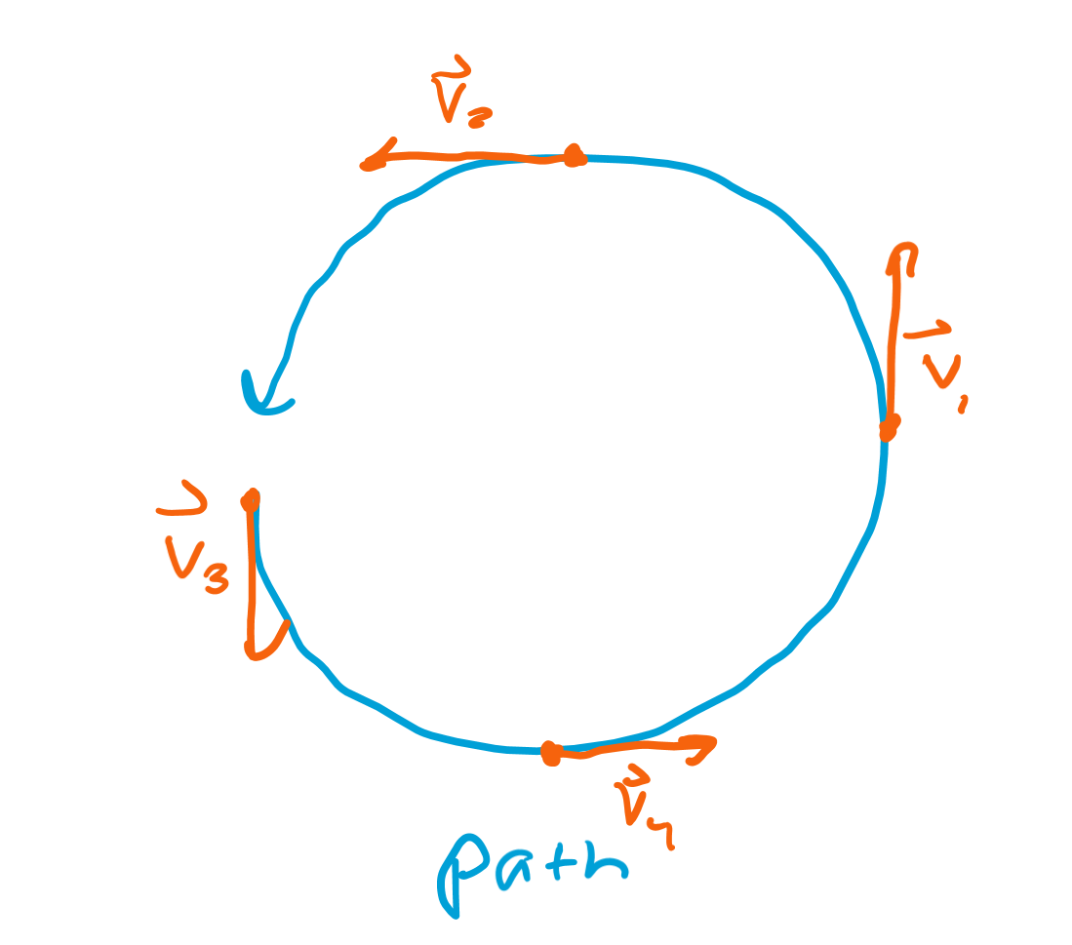
Direction of velocity
Velocity is always tangent to the path, so the direction of velocity will always be tangent to the circular path.
As the ball travels along the circular path, the velocity vector also rotates 2π radians, from pointing up to down to up again.

Slide 5
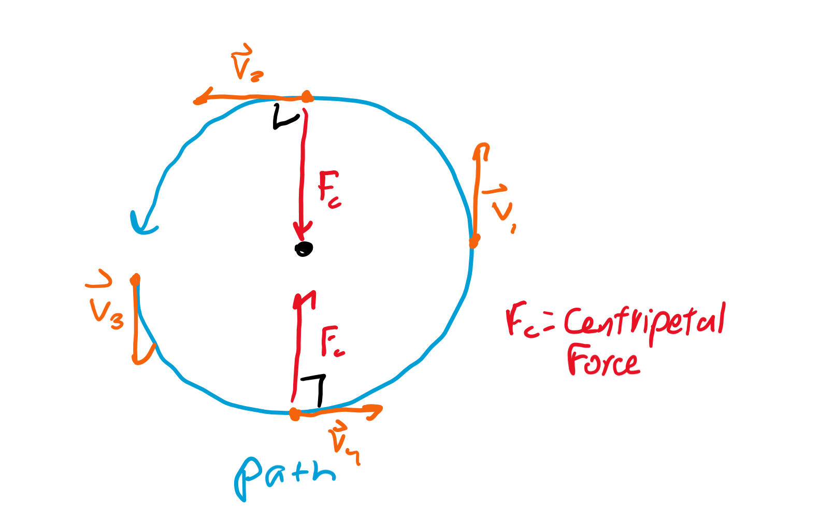
Direction of force
Imagine a ball tied to a rope spinning in a circle. To keep the ball from flinging out, what direction would you spin the ball in?
An inward force should keep the ball in a circular orbit!

Slide 6
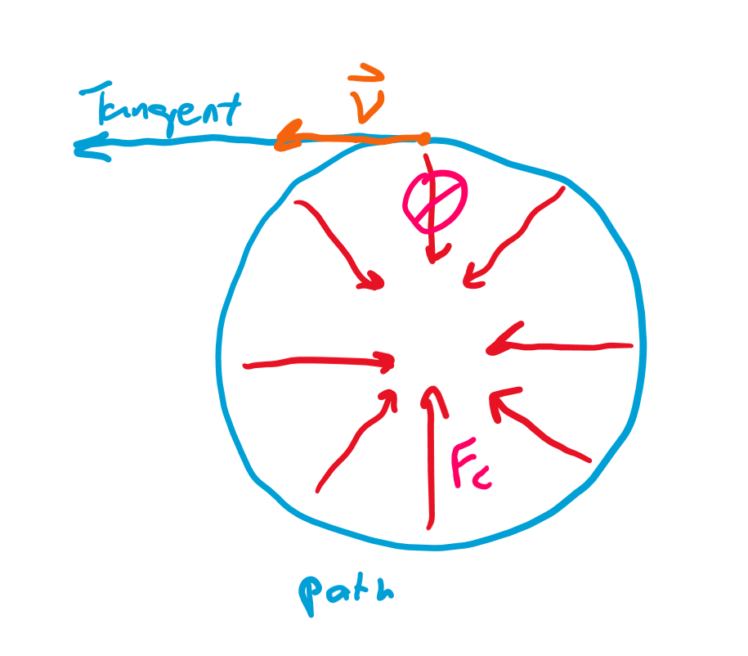
Force removed
What happens if we remove the force? Which direction would the ball travel?
The ball would travel tangent to the original path, or in a line that touches the path at exactly one point, the point at which the ball was flung out.

Slide 7
Equation
We can write the strength of the force with respect to the mass of the object, the velocity, and the distance it is away from the center point.
F = mv²/r. Since F = ma, this is also a = v²/r.

Slide 8
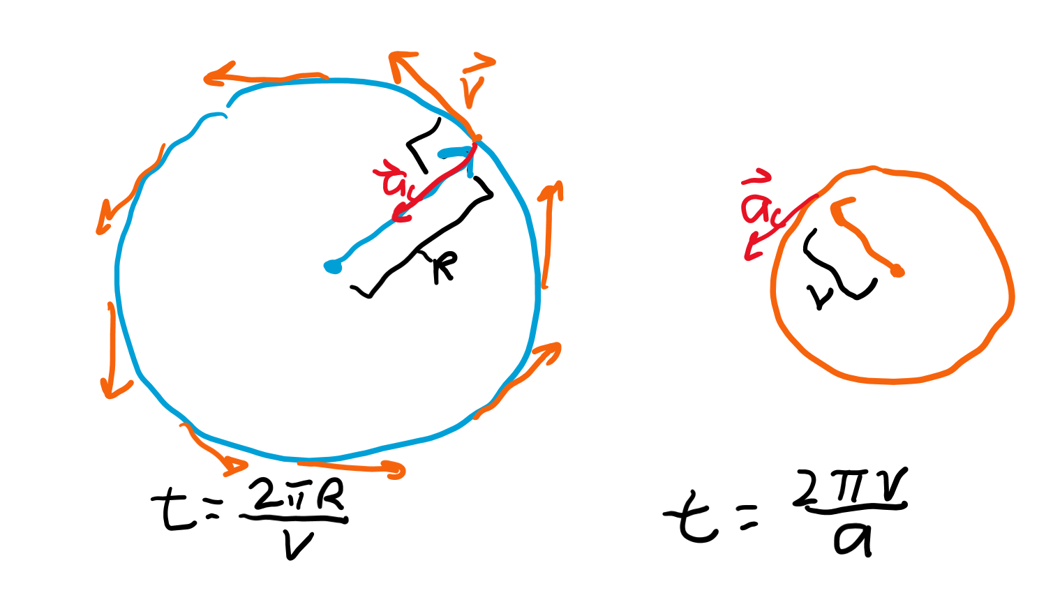
Derivation
The path has distance x = 2πR, and velocity v. Since velocity is distance over time, t = x/v = 2πR/v.
The velocity vector also rotates a full 360 degrees in that same time t, and we know velocity over time is acceleration. Thus, rearrange a = v/t to t = v/a = 2πv/a.
Since these are both the same time, that means 2πR/v = 2πv/a, so a = v²/R, and we can multiply m to both sides to make it the force equation.

Slide 9
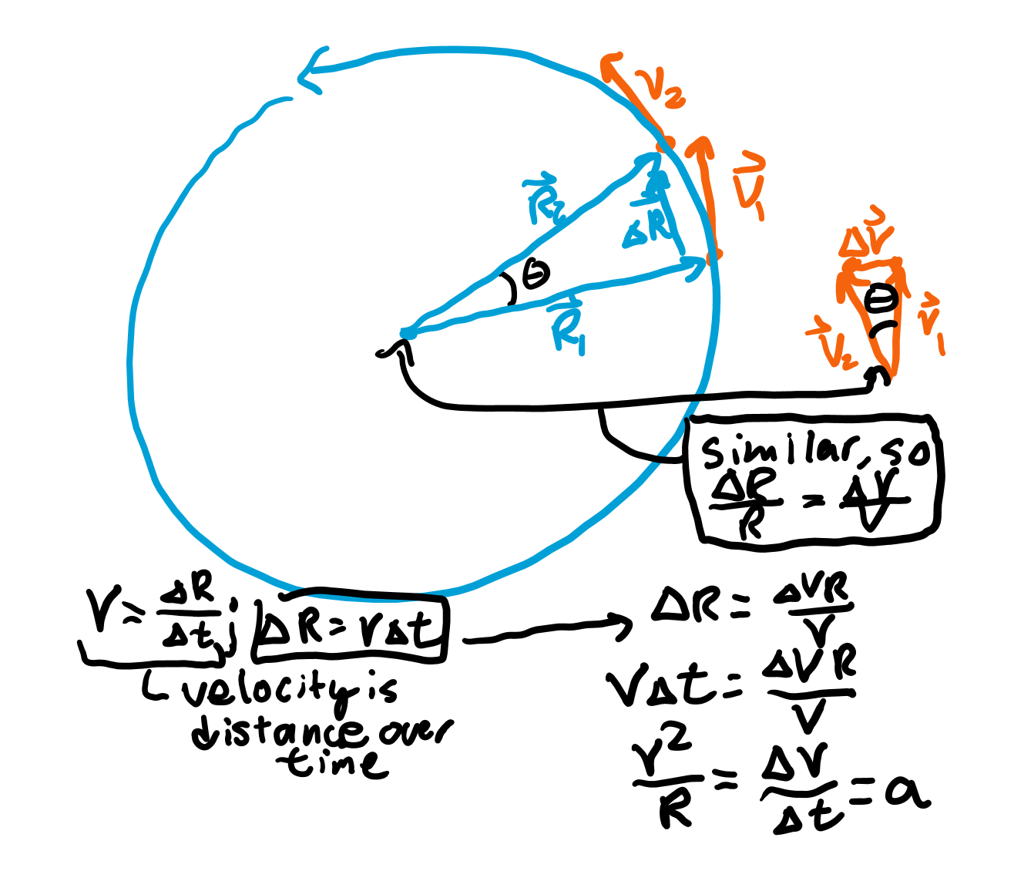
Harder derivation

Slide 10
Gravitation

Slide 11
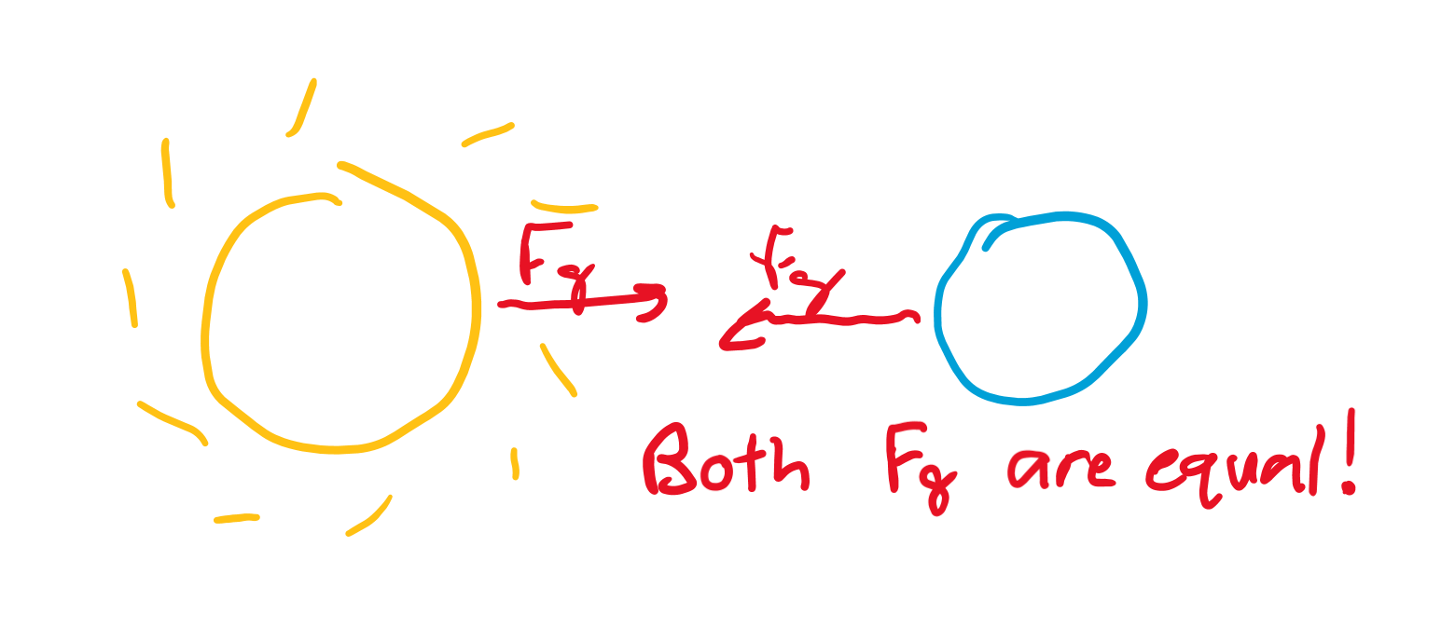
Equal and opposite
The force one object applies to the other equals the force the other object applies to the original.
The only difference is the direction in which the forces act on each object.

Slide 12
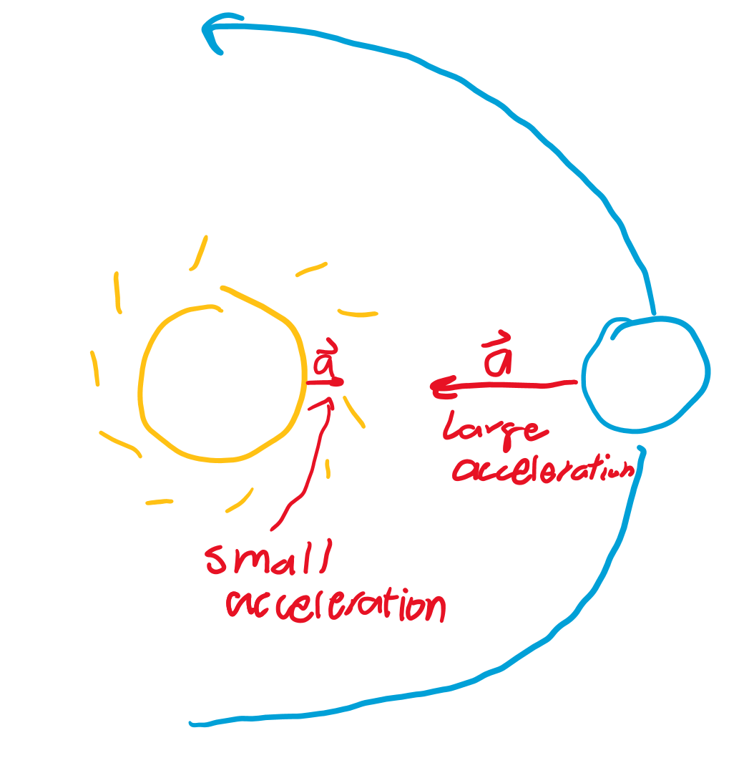
Large objects
The large object, though it has the same force applied to it, will barely move because of its large mass.
Thus, we can assume it remains stationary as the smaller mass accelerates inwards toward it.

Slide 13
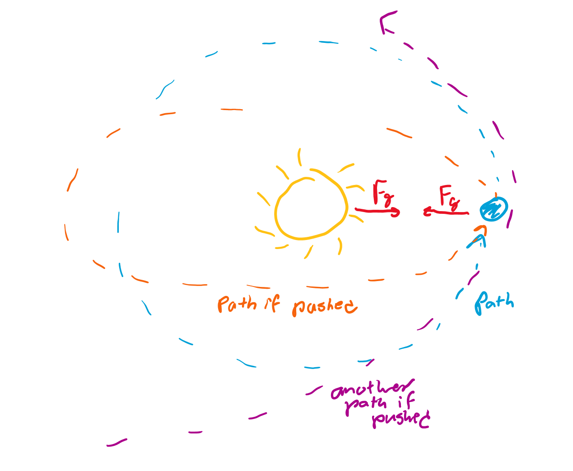
Direction of gravitational force
We can think of one object as the center of motion and the other as the object rotating in a “circle” around the other object.
However, if we give one of the planets a little “push,” we can change their orbits into an elliptical one, or even parabolic if it leaves orbit.

Slide 14
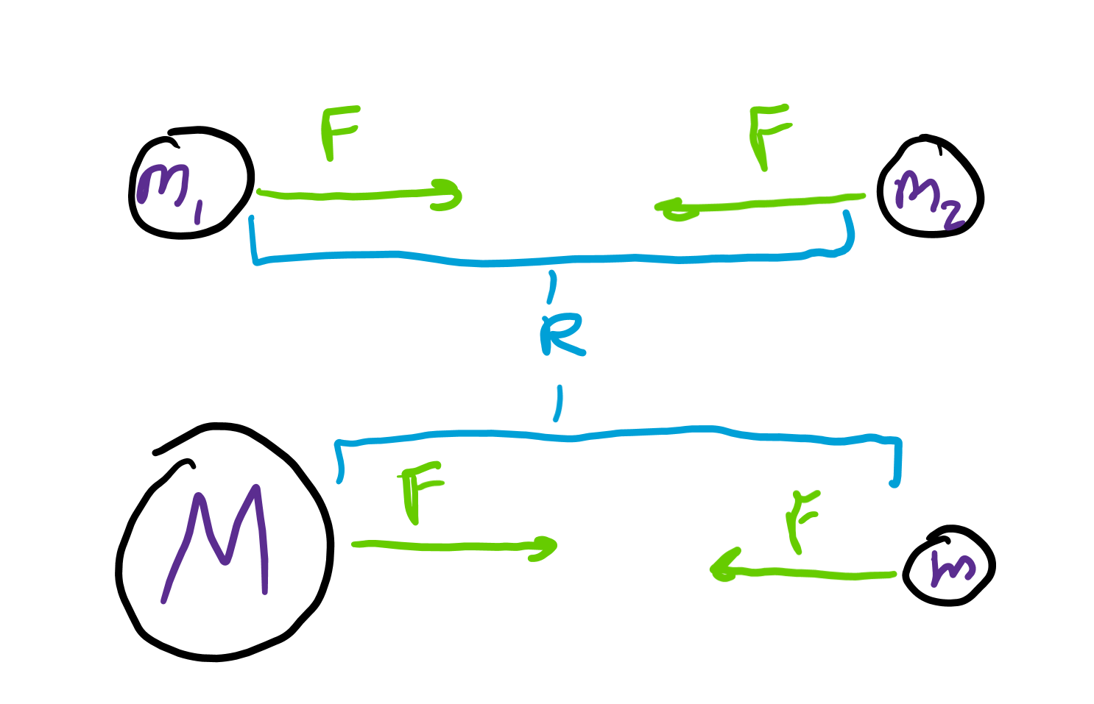
Newton’s law of universal gravitation
Newton wrote a law that follows large enough objects: F_{g} = Gm₁m₂/R², where F_{g} is the gravitational force, G is a constant, m₁ , m₂ are the mass of objects 1 and 2 that are gravitationally attracted, and R is the distance between planets (or radius of orbit).
Sometimes this is written F = GmM/R² where m is the mass of the smaller object (a planet) and M is the mass of the larger object (the sun).

Slide 15
Units for big G
Let x represent the units for G.
Since F = GmM/R²: N = x(kg)²/m², so x = Nm²/(kg²).
Since N = kg*m/s², this gives: X = m³/(kg*s²).
The exact value of G is: 6.67430 * 10⁻¹¹ m³/(kg*s²).

Slide 16
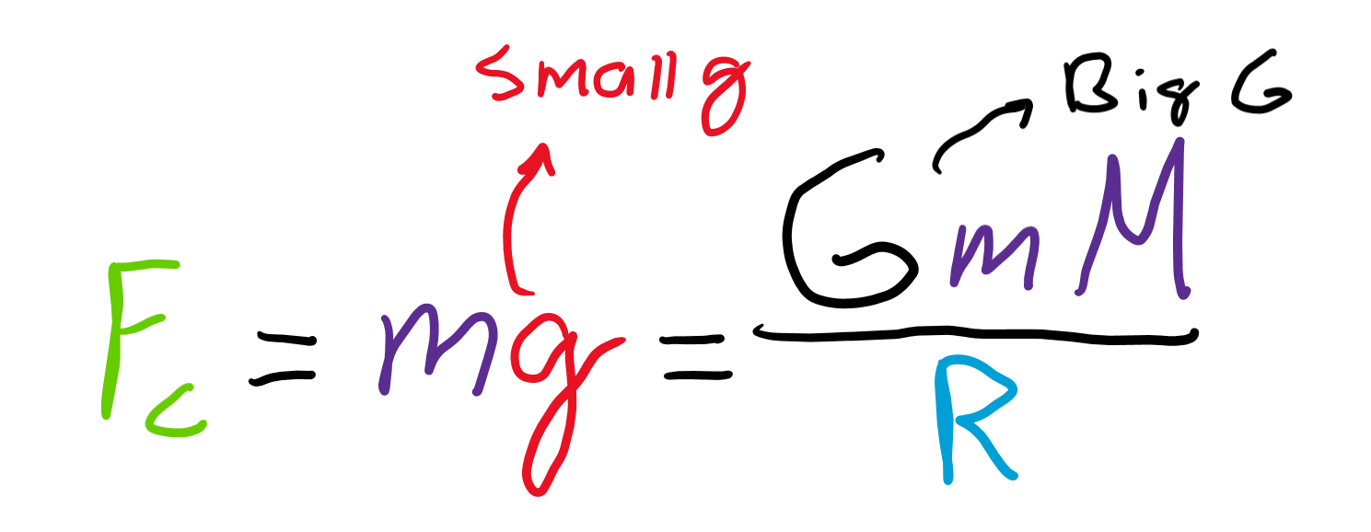
More on big G
Big G stands for the gravitational constant and describes how much large objects in space are attracted to each other by gravity.
This is not small g, which is the gravitational acceleration which can be calculated by using big G and the mass and radius of a planet.

Slide 17
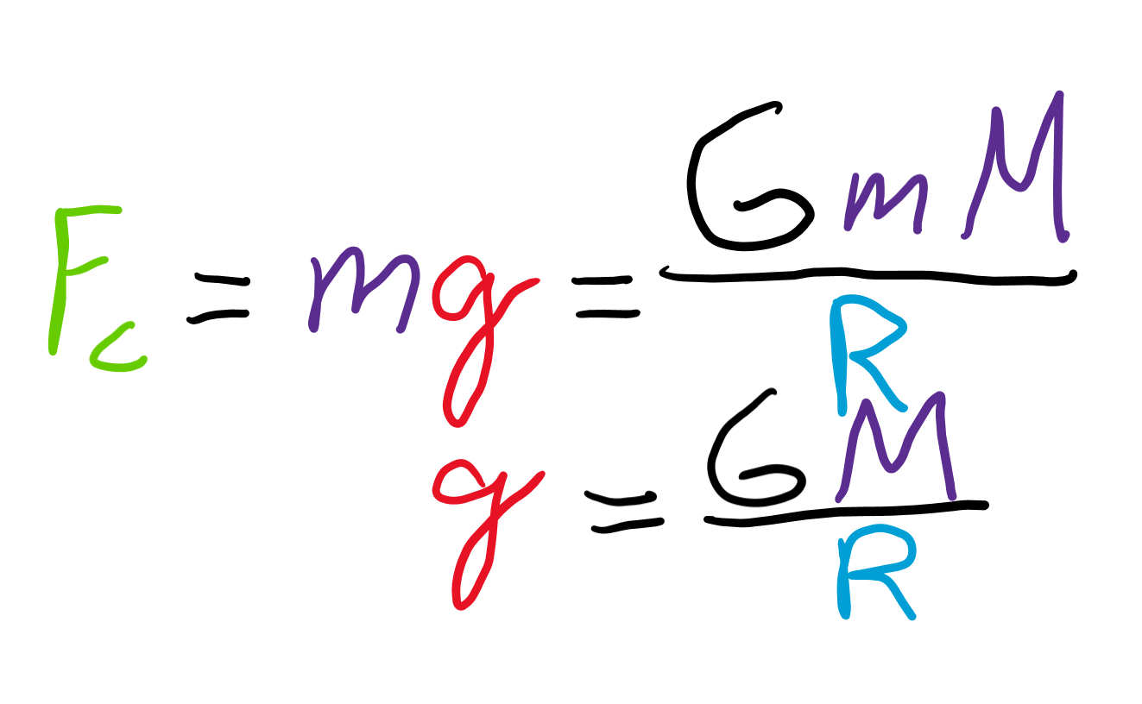
Calculating g
F = GmM/R², where M is the mass of the planet, R is the radius of the planet, and m is the mass of a falling object on the planet.
Let F represent the force on the falling object, so F = ma = GmM/R², so a = GM/R². As a represents gravitational acceleration, g for Earth can be calculated by plugging in M and R for Earth!

Slide 18
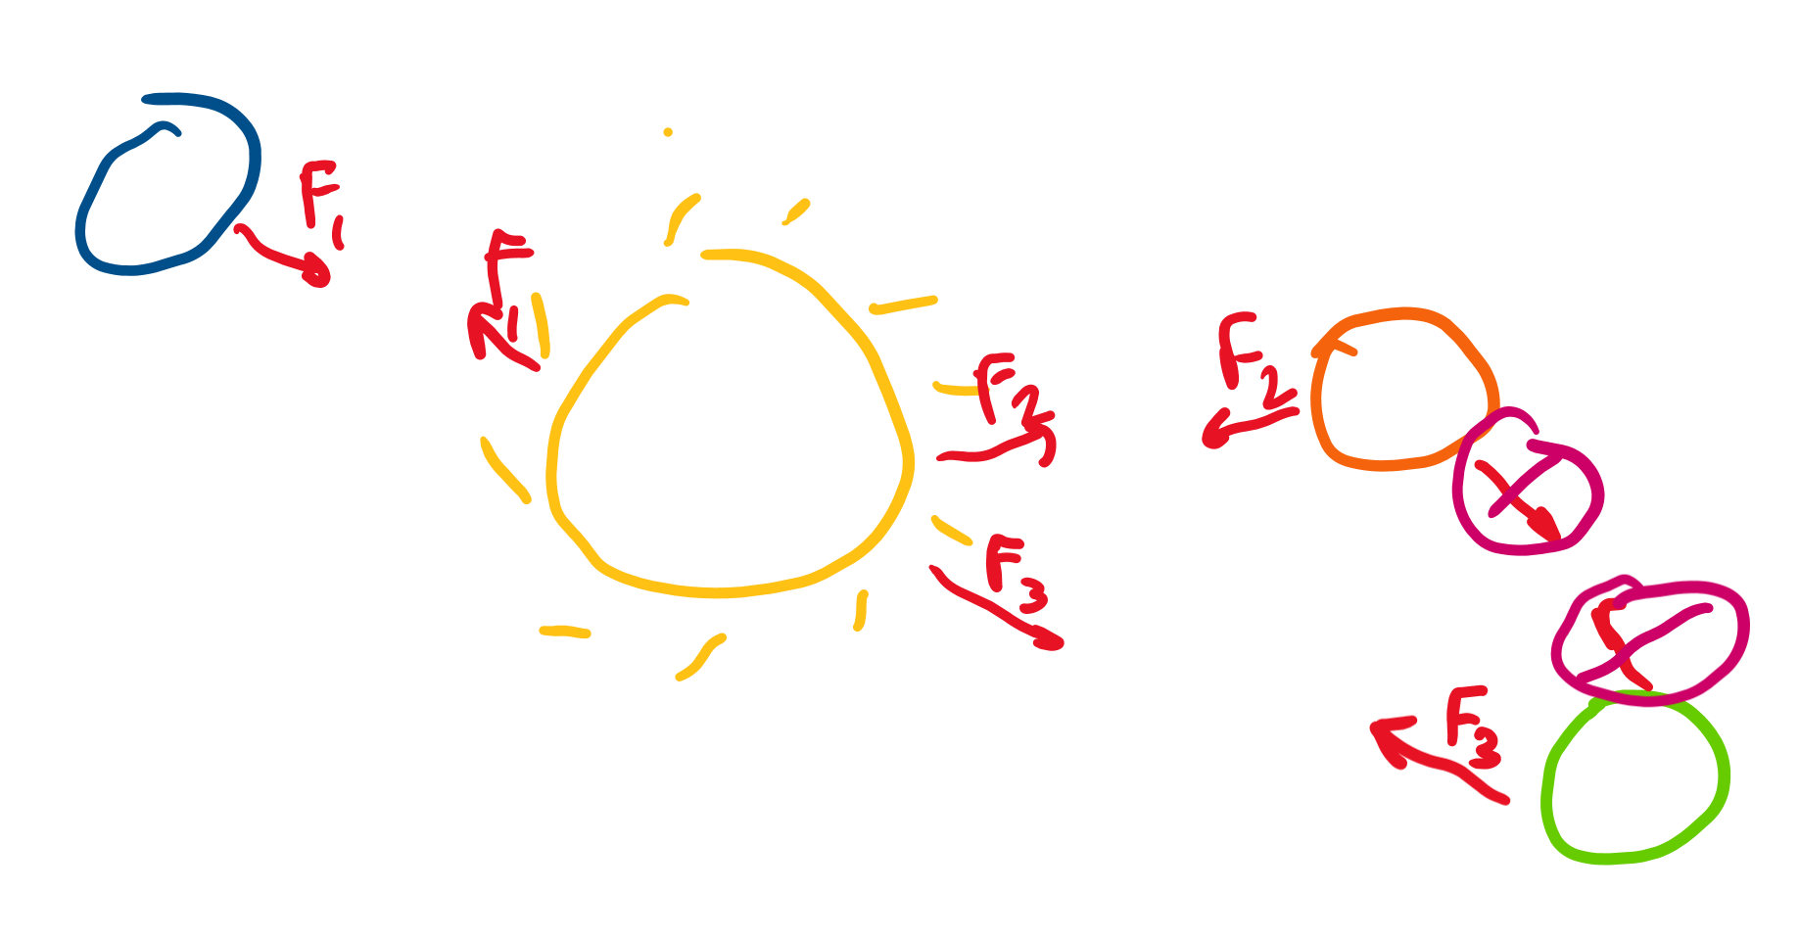
Three body system
If we have a large object and several smaller objects gravitationally attracted to each other, we often assume the smaller objects apply a negligible force on each other.
This is because three objects all applying force on each other is very complicated and chaotic to model, which is what many learn about in chaos theory.

Slide 19
Energies

Slide 20
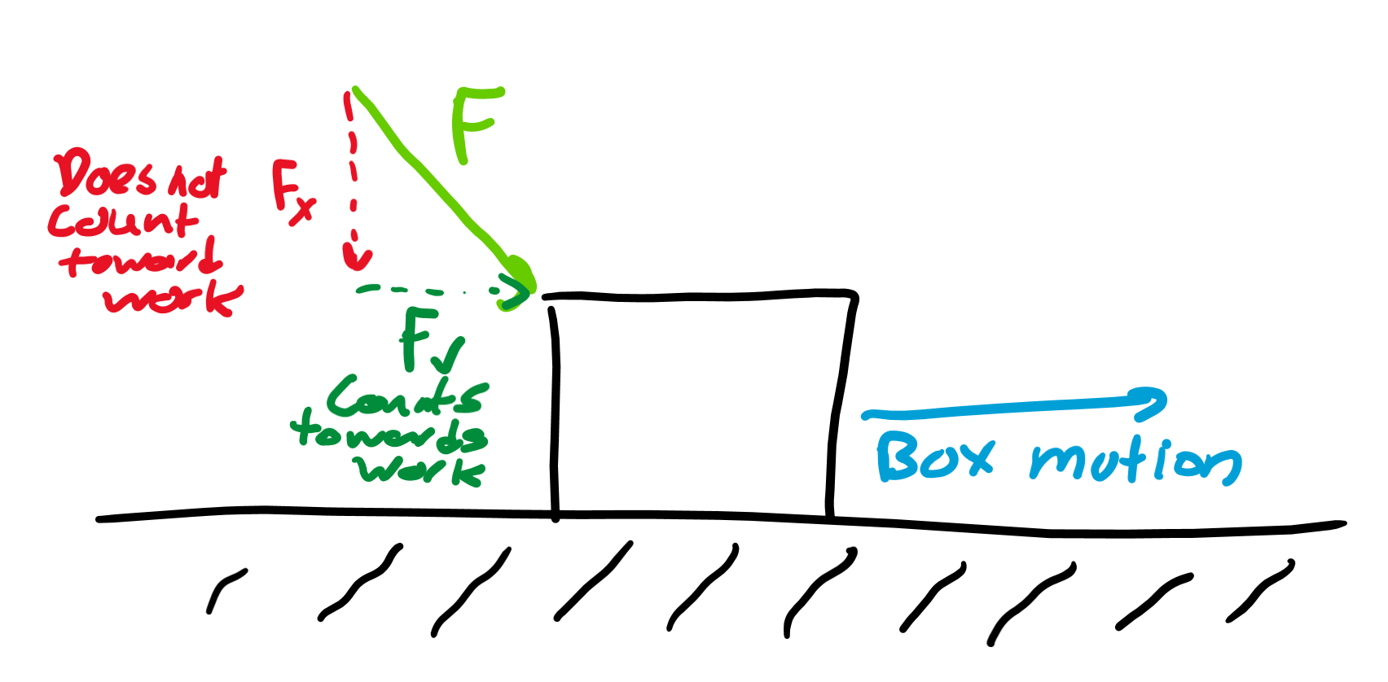
Work
Work is force applied over a certain distance. W = F * d = FΔx.
However, only force done in the same direction as the distance traveled counts as work.
Lifting a book up takes work as you have a force going up to counteract gravity, but walking a constant velocity with a book requires no work as no force is applied!

Slide 21
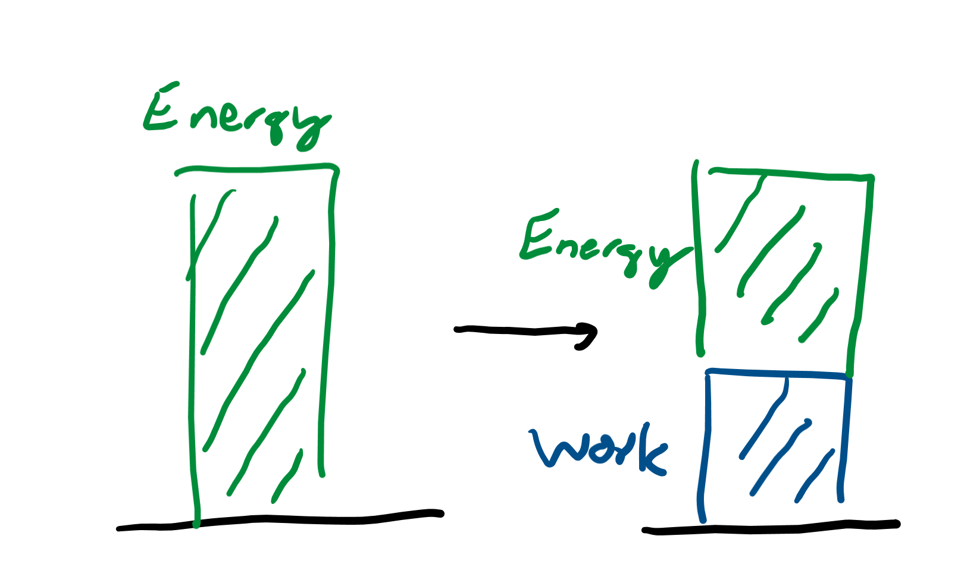
Energy
Energy is the ability to do work. If you have energy, you can apply a force over a distance.
The unit for energy and work is a Newton meters, since you multiply force (Newton) by distance (meter).
This is more commonly referred to as a Joule (J = Nm).

Slide 22
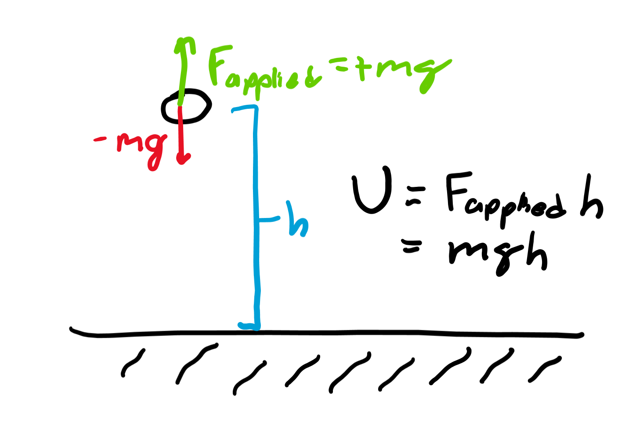
Potential energy
This is energy stored in position.
For gravity, this is the energy you need to apply a force to counteract gravity for a certain height. In other words, this is gravitational force times height, also written as U = m*g*h.
Yep, U is the letter usually used to denote potential energy.

Slide 23
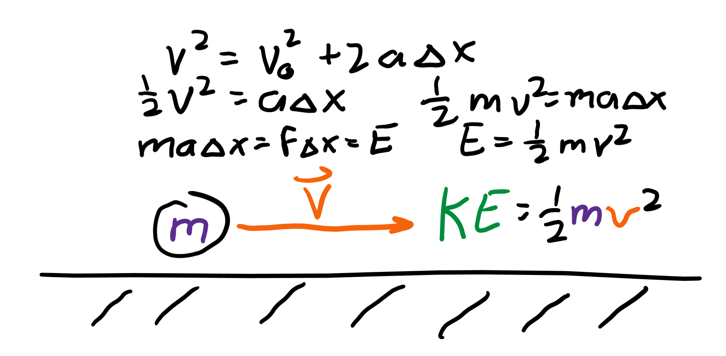
Kinetic energy
This is the energy of motion. All objects with velocity have this energy.
Imagine you want to accelerate an object to a velocity v from rest. We know by the time not found equation: v² = v₀² + 2aΔx, and initial velocity is 0, so v² = 2aΔx, and ½ v² = aΔx. Since W = F*Δx = maΔx, we multiply both sides by m to get W = ½ mv², or KE (kinetic energy) = ½ mv².

Slide 24
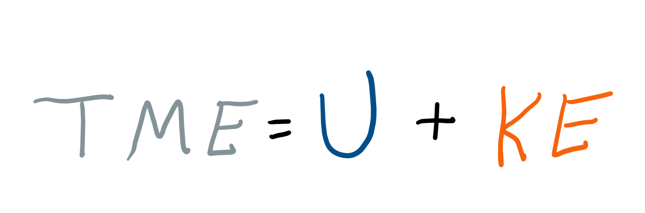
Total mechanical energy
This is just the sum of potential and kinetic energies!

Slide 25
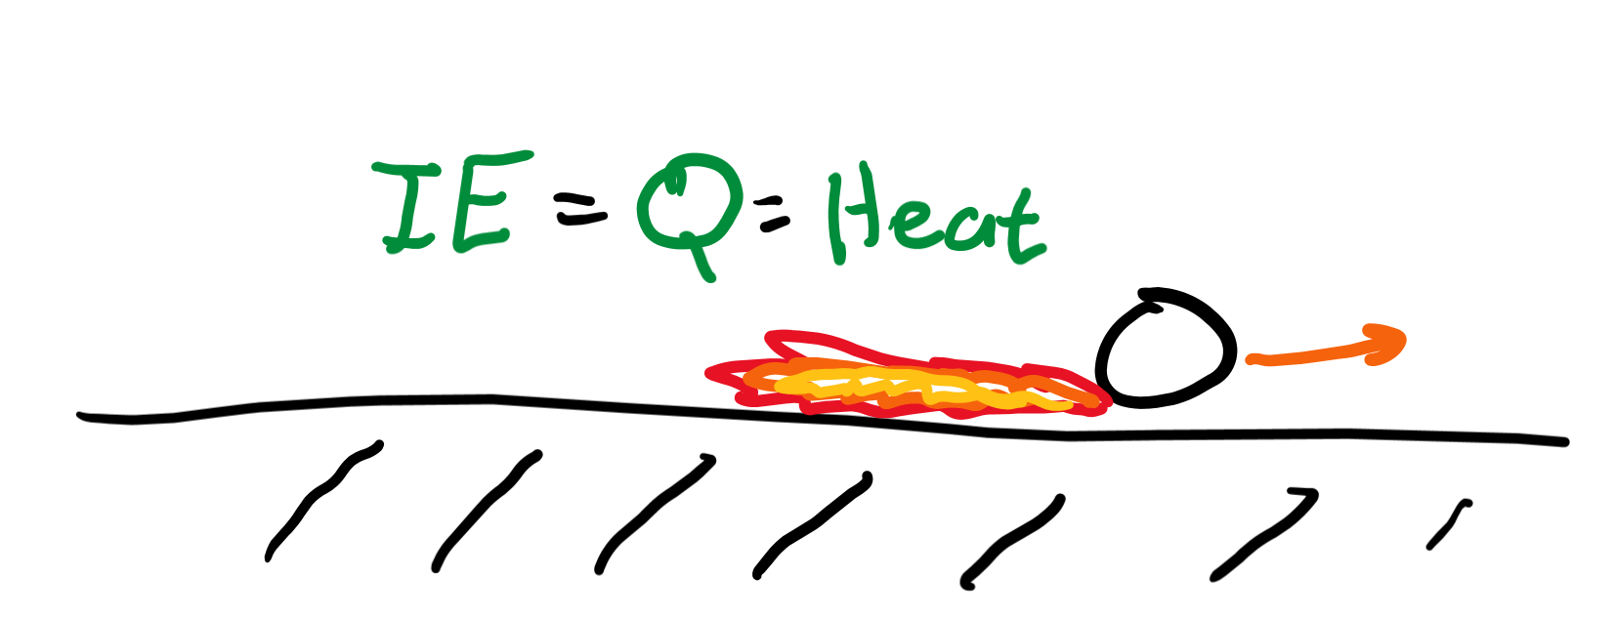
Internal energy
This is heat energy that might be released due to things like friction breaking objects or air resistance stealing energy from a falling object.

Slide 26
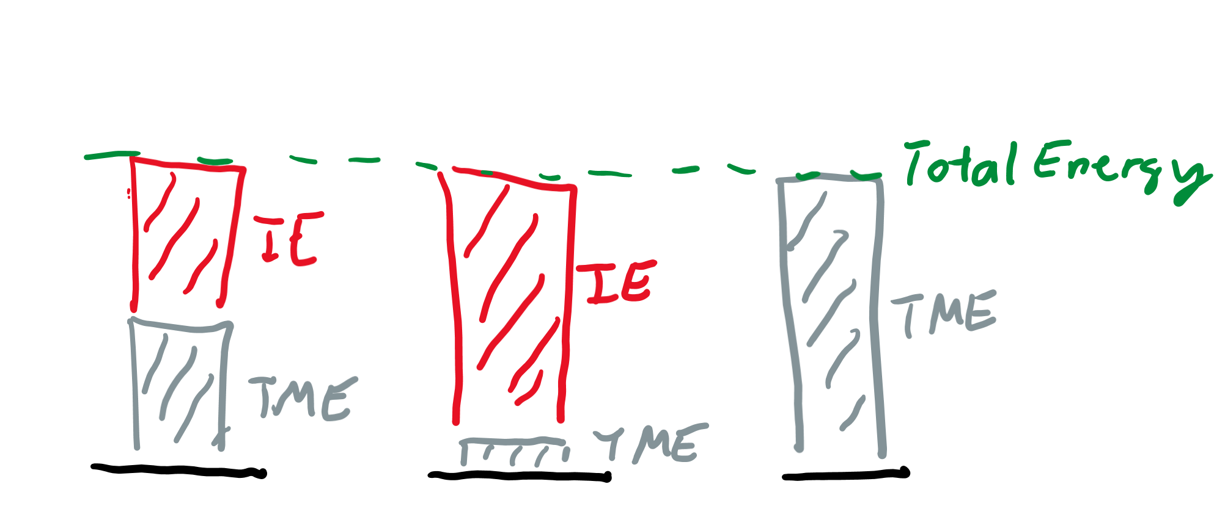
Law of conservation of energy
This says that the sum of TME (total mechanical energy) and IE (internal energy, also known as Q, heat) must stay constant over time.
In other words, total energy is conserved!

